Slide 1

Machine Learning-Based Prediction and Optimization of Microhardness and Relative Density in Selective Laser Melted Inconel 718
Guided by:
Prof. Arun B S
Assistant Professor
Presented by:
Abhinav U ( Roll no: 4 )
Arjun M Nair ( Roll no: 17 )
Anurag T K (Roll no: 86 )
Vishal Krishna S ( Roll no: 83 )
Department of Mechanical Engineering
College of Engineering Trivandrum

Slide 2
CONTENTS
Introduction
Literature Review
Research Gap and Objectives
Methodology
Conclusion
References

Slide 3
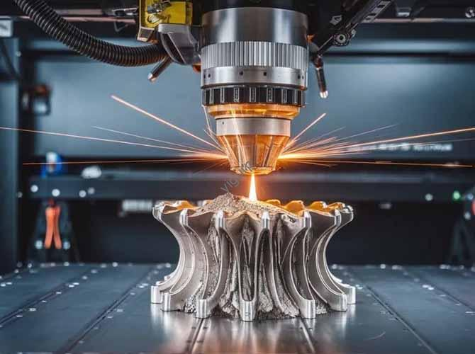
INTRODUCTION
Additive Manufacturing
Layer-by-layer fabrication directly from CAD models.
Enables complex geometries with reduced material waste.
Selective Laser Melting (SLM)
Laser Powder Bed Fusion process for manufacturing fully dense metallic components.
Widely adopted for aerospace and high-performance engineering applications.
Fig 1. Selective Laser Melting (image source: yigurp.com)

Slide 4
INTRODUCTION…
Inconel 718
Nickel-based precipitation-hardenable superalloy.
Excellent strength, corrosion resistance, and high-temperature performance.
Commonly used in turbine engines, aerospace, and power generation and in industries requiring high strength, excellent corrosion resistance, and superior performance at elevated temperatures.
It also exhibits excellent fatigue, creep, and oxidation resistance, making it one of the most extensively used superalloys in demanding engineering applications.

Slide 5
INTRODUCTION…
Applications of Inconel 718
Aerospace: Turbine discs, compressor blades, combustion chambers, and jet engine components.
Gas Turbines: Turbine blades, rotors, and hot-section components.
Oil and Gas: Downhole tools, valves, wellhead equipment, and drilling components.
Nuclear Industry: Reactor components and steam generator parts.
Chemical Processing: Heat exchangers, pressure vessels, pumps, and piping systems exposed to corrosive environments.
Automotive and Power Generation: Turbocharger components, exhaust systems, and high-temperature structural parts.

Slide 6
LITERATURE REVIEW
Sl No. | Article | Journal | Year | Key Finding
1. | Effects of Process Parameters and Heat Treatment on Microstructure and Mechanical Characteristics of Laser Powder Bed Fusion Alloy Inconel 718 | Coatings (MDPI) | 2023 | Process parameters significantly influence porosity; An energy density of 60 J/mm³ achieved minimum porosity (0.15%), while non-optimal energy densities increased defects.
2. | Formability, Microstructure and Properties of Inconel 718 Superalloy Fabricated by Selective Laser Melting Additive Manufacture Technology | Materials | 2021 | Laser energy density directly affects the microhardness of SLM Inconel 718; strongly influenced microhardness, with higher energy densities producing greater hardness (290.2–348 HV₀.₂).
3. | Data-driven printability mapping of Lpbf of Inconel 718 | The International Journal of Advanced Manufacturing Technology | 2026 | Machine learning models can accurately predict the relative density of SLM Inconel 718 from process parameters, enabling efficient process optimization.
4. | Effect of building orientation & heat-treatment on microhardness & surface roughness of additive manufactured IN718 alloy | Materials Today : Proceedings | 2022 | Build orientation significantly influences the microhardness of additively manufactured IN718.

Slide 7
LITERATURE REVIEW…
SLM process parameters such as laser power, scanning speed, layer thickness, etc as well as build orientation significantly influence melt pool characteristics, relative density and defect formation.
These processing conditions govern grain morphology, dendritic growth, crystallographic texture and precipitate evolution, resulting in different microstructures.
Heat treatment further modifies the γ′, γ″, δ and Laves phases, enhancing strength while reducing microstructural heterogeneity.
The combined effects of process parameters, microstructure and heat treatment determine the mechanical properties, including tensile strength, porosity, hardness and anisotropy, of SLM-fabricated Inconel 718.
These studies establish a clear process–structure–property relationship, providing the basis for developing Machine Learning models to predict microhardness and relative density and optimize SLM process parameters.

Slide 8
GAPS IDENTIFIED AND OBJECTIVES
RESEARCH GAP
The influence of build orientation on the relative density and microhardness of SLM Inconel 718 has not been comprehensively investigated, particularly in relation to different process parameter combinations.
The integration of machine learning for predicting and optimizing the density and microhardness of SLM Inconel 718 based on process parameters and build orientation remains limited and requires further study.

Slide 9
GAPS IDENTIFIED AND OBJECTIVES
OBJECTIVES
Evaluate the effect of build orientation on the relative density and hardness of SLM-fabricated Inconel 718.
Investigate the influence of key SLM process parameters (laser power, scan speed, layer thickness and build orientation) on material properties.
Determine the optimal build orientation for achieving improved hardness and density.
Develop a Machine Learning model to predict hardness and density from SLM process parameters.
Validate the predicted results through experimental studies and comparison with published literature.

Slide 10
METHODOLOGY
Literature Survey
Review published research on SLM Inconel 718.
Identify process parameters and reported material properties.
Dataset Preparation
Extract process parameters and experimental results.
Organize the data into a structured Excel database and convert it to CSV for analysis.
Machine Learning
Train regression models to predict hardness and density from SLM process parameters.
Evaluate model accuracy using appropriate performance metrics (e.g., MAE, RMSE, R²).
Experimental Validation
Fabricate Inconel 718 specimens using SLM.
Measure density, microhardness and examine the microstructure.
Compare experimental observations with model predictions and published literature.

Slide 11
CONCLUSION
Process parameters significantly influence the density and microhardness of SLM Inconel 718, as demonstrated by the reviewed literature.
However, the combined effect of build orientation on these properties remains insufficiently explored.
This project aims to investigate the influence of build orientation on density and microhardness and develop a machine learning model to predict and optimize these properties using process parameters.
The outcomes are expected to support the optimization of SLM process parameters, reduce experimental effort, and improve the quality and performance of Inconel 718 components.

Slide 12
REFERENCES
[1] H. Liu, W. Cheng, Y. Sun, R. Ma, Y. Wang, J. Bai, L. Xue, X. Song, and C. Tan, Effects of Process Parameters and Heat Treatment on Microstructure and Mechanical Characteristics of Laser Powder Bed Fusion Alloy Inconel 718, Coatings, vol. 13, no. 1, Art. no. 189, 2023.
[2] X. Liu, K. Wang, P. Hu, X. He, B. Yan, and X. Zhao, Formability, Microstructure and Properties of Inconel 718 Superalloy Fabricated by Selective Laser Melting Additive Manufacture Technology, Materials, vol. 14, no. 4, Art. no. 991, 2021.
[3] S. B. Yusuf and R. Sudhakarapandian, Q-Learning Algorithm for Predicting Mechanical Properties of Inconel 718 Processed by Selective Laser Melting, Applied Sciences, vol. 16, Art. no. 181, 2026.
[4] H. Deng, Y. Wang, L. Lv, S. Zhang, Q. Bian, J. Luo, Z. Wu, Z. Liu, Z. Chen, L. Tan, and F. Liu, Orientation dependence of microstructure and mechanical property in selective laser-melted Inconel 718 alloy, Materials Characterization, vol. 220, Art. no. 114664, 2025.
[5] Jung Hyun Park, Gyung Bae Bang, Kee-Ahn Lee, Yong Son, Won Rae Kim, Hyung Giun Kim, Effect on microstructural and mechanical properties of Inconel 718 superalloy fabricated by selective laser melting with rescanning by low energy density. Journal of Materials Research and Technology, 2020

Slide 13
REFERENCES
[6] Deng, D., Moverare, J., Peng, R., Söderberg, H., & Andersson, J. (2017). Microstructure and mechanical properties of Inconel 718 produced by selective laser melting: Sample orientation dependence and effects of post heat treatments. Materials Science and Engineering A, 713, 294–306.
[7] Guo, Q., Zhao, C., Qu, M., et al. (2022). Effects of laser scanning speed and building direction on the microstructure and mechanical properties of selective laser melted Inconel 718 superalloy. Materials Today Communications, 31, 103565.
[8] Li, Y., et al. (2025). Effect of heat treatment on the microstructure and mechanical anisotropy of selective laser-melted Inconel 718 alloy. Materials Today Communications.
[9] K. Moussaoui, W. Rubio, M. Mousseigne, T. Sultan, and F. Rezai, Effects of Selective Laser Melting additive manufacturing parameters of Inconel 718 on porosity, microstructure and mechanical properties, Mater. Sci. Eng. A, vol. 735, pp. 182–190, 2018.
[10] J. H. Park, G. B. Bang, K.-A. Lee, Y. Son, W. R. Kim, and H. G. Kim, Effect on microstructural and mechanical properties of Inconel 718 superalloy fabricated by selective laser melting with rescanning by low energy density, J. Mater. Res. Technol., vol. 10, pp. 785–796, 2021.

Slide 14
Thank You!

